Slide 1
DYSLEXIA –AWARENESS SEMANTIC GRADER SYSTEM
GUIDED BY
MR.S.HARI KRISHNA
Assistant Professor
PRESENTED BY
CSM(AIML) 3-2 BATCH 17
B. Mounika -23SS1A6608
P. Adith– 23SS1A6645
P. Pavithra Chary- 23SS1A6648
P. Ram Charan- 23SS1A6649

Slide 2
Table of Contents
Introduction
Problem statement
Literature survey
Existing system
Proposed System
Hardware Requirements
Software Requirements
System Architecture
UML diagrams
Results
Conclusion
Future scope
References

Slide 3
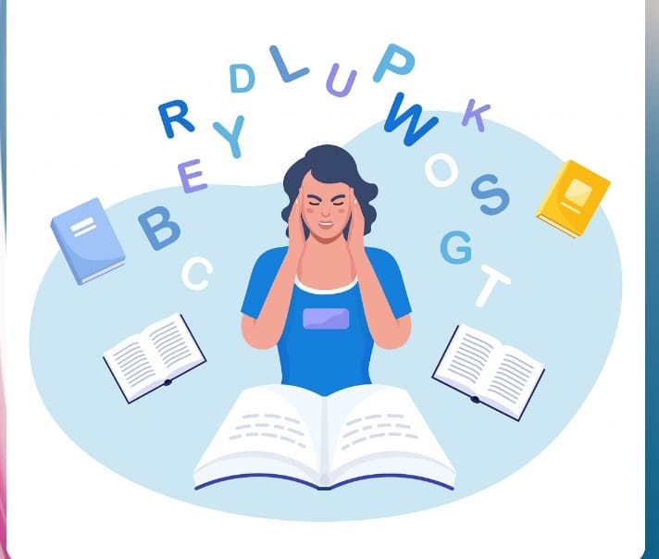
Introduction
Dyslexia is a learning disorder impacting reading, spelling, and writing. Traditional grading often penalizes these students for surface-level errors rather than recognizing their conceptual understanding.
To solve this, the Dyslexia-Aware AI Semantic Grader uses Natural Language Processing to evaluate the meaning of responses. By focusing on semantic similarity instead of spelling, the system ensures fair assessment and promotes inclusive education.

Slide 4
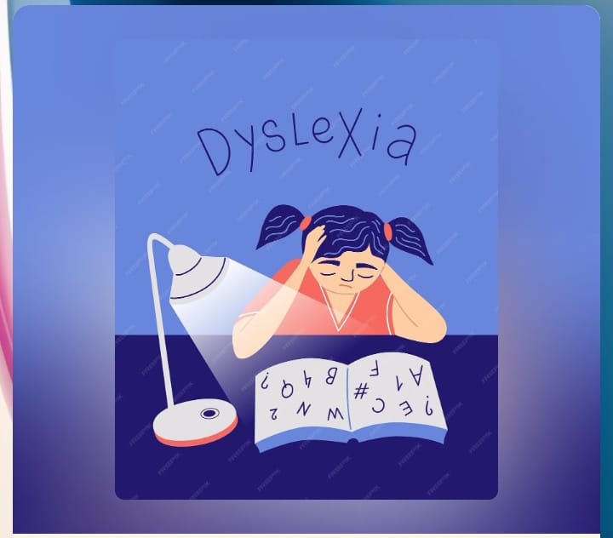
Problem Statement
Students with dyslexia frequently lose marks due to spelling errors, even when they demonstrate a clear understanding of the subject matter.
There is a critical need for an intelligent system that evaluates answers based on semantic understanding rather than surface-level writing accuracy.

Slide 5
Literature Survey
Research indicates that NLP and Machine Learning can be leveraged to extract text and analyze semantic similarity.
By using datasets from sources like Kaggle, models can be trained to understand context and intent, providing a more balanced alternative to literal string-matching algorithms.

Slide 6
Existing System
Current grading methods are primarily manual or rely on basic automated tools that penalize spelling mistakes.
Limitations: Manual grading is time-consuming and often fails to recognize the intended meaning behind misspelled words.
Impact: This creates an unfair bias against dyslexic students, leading to lower marks despite having the correct concepts.

Slide 7
Proposed System
The proposed system uses a combination of AI and NLP to create a "Dyslexia-friendly" evaluation environment.
Meaning-Based Scoring: Marks are awarded based on how closely the student's concept matches the reference answer.
Inclusive Design: It supports inclusive learning by recognizing the knowledge of students with learning disabilities.

Slide 8
Hardware Requirements
Standard modern processor (Intel i5 or higher)
8GB RAM,
SSD storage for efficient model processing.

Slide 9
Software Requirements
Language: Python.
Libraries: NLP libraries, Machine Learning models, and Text Similarity Algorithms.
Dataset: Kaggle-sourced data for training.

Slide 10
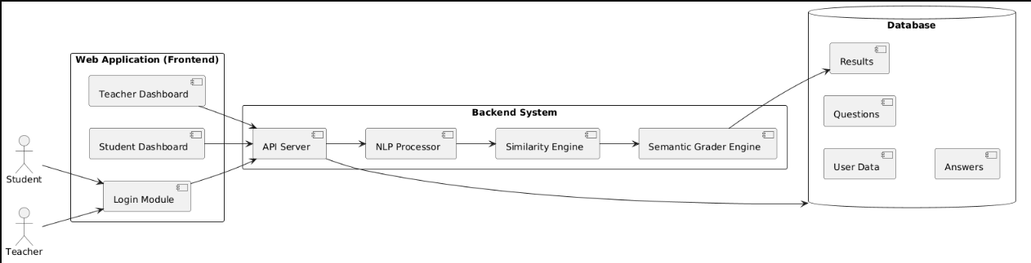
System Architecture

Slide 11
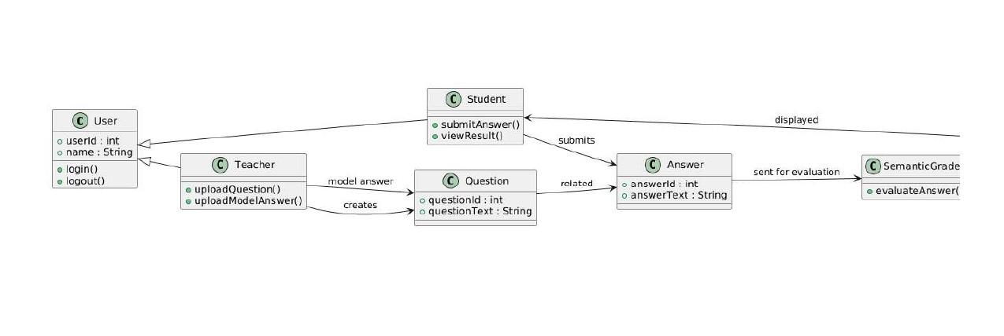
Class Diagram

Slide 12
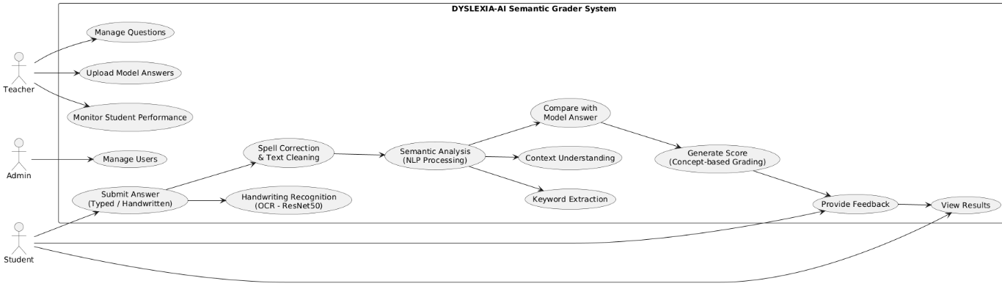
Use Case Diagram

Slide 13
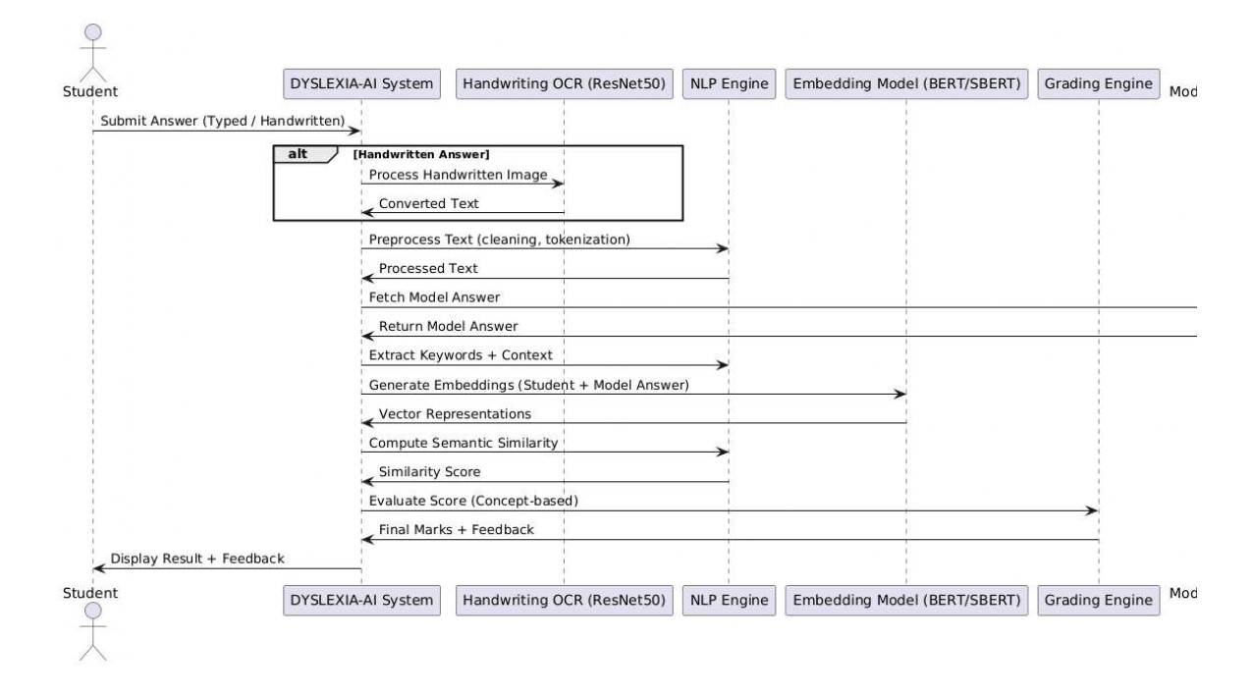
Sequence Diagram

Slide 14
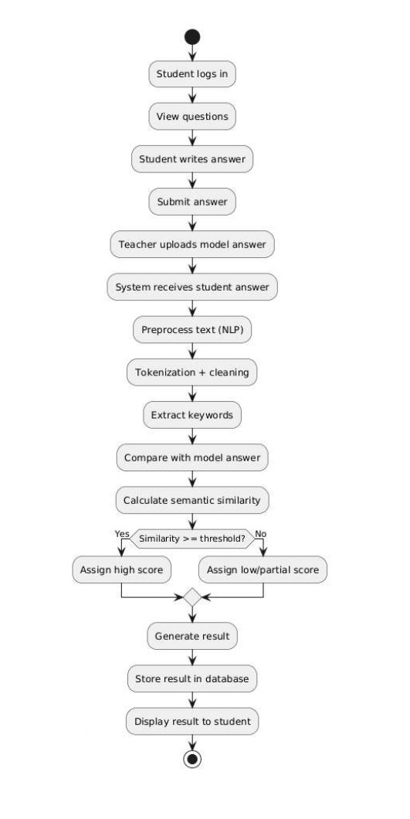
Activity Diagram

Slide 15
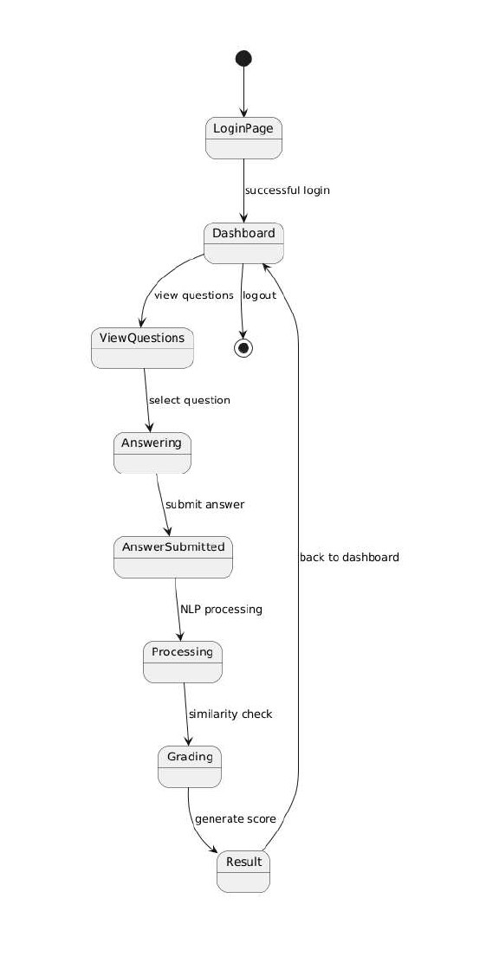
State Diagram

Slide 16
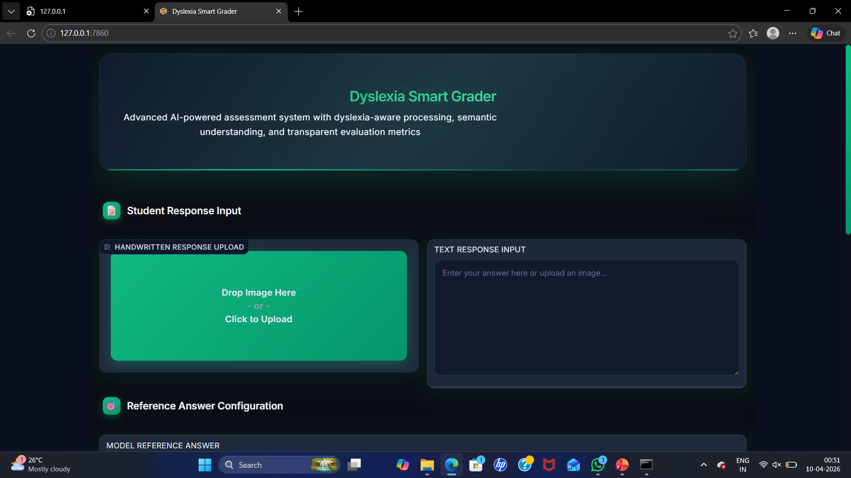
Results

Slide 17
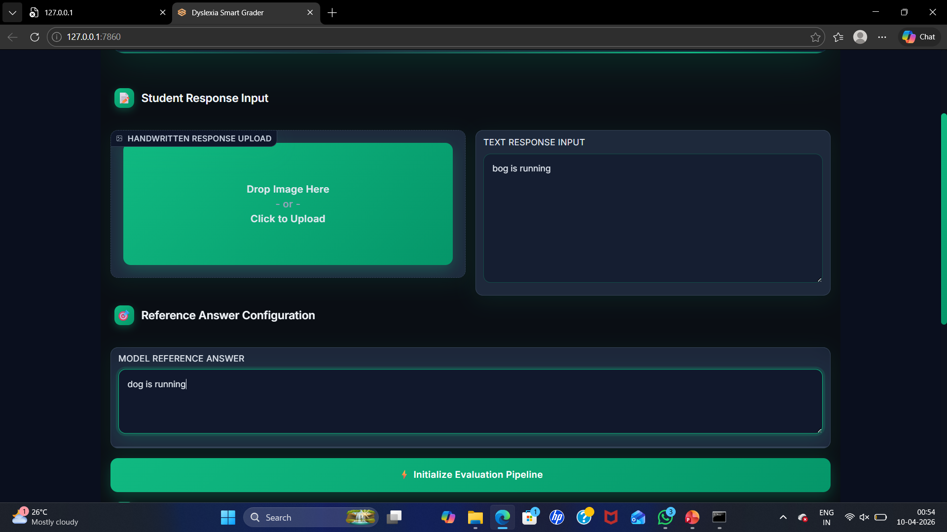
Response Input & Model Reference Answer

Slide 18
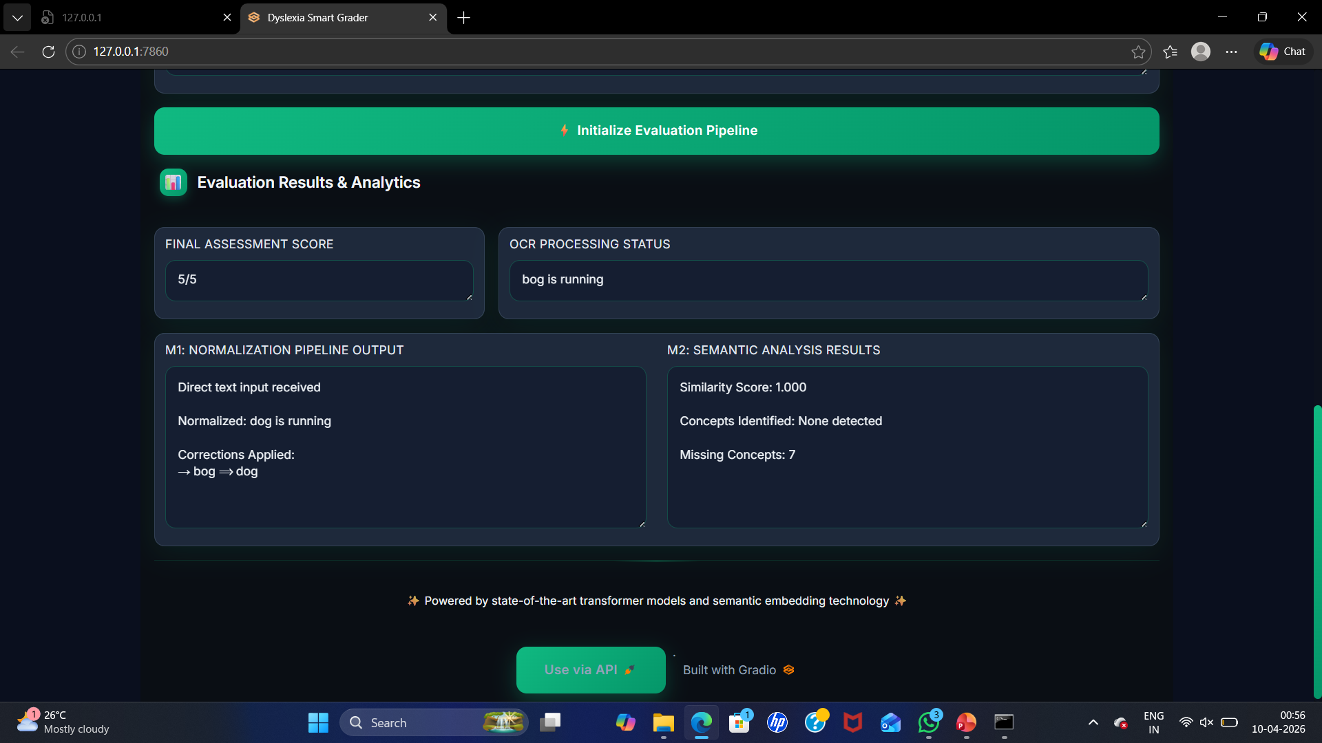
Evaluation Pipeline

Slide 19
Conclusion
The Dyslexia-Aware AI Semantic Grader provides a fair way to evaluate students by focusing on meaning and concepts rather than spelling. By using NLP, it removes traditional grading bias and supports inclusive education. This technology ensures students are judged on their actual knowledge, helping them succeed regardless of writing challenges.

Slide 20
Future scope
Global Use: Support for multiple languages.
Better OCR: Improved recognition of reversals and spacing.
LMS Sync: Integration with Moodle or Canvas.
Voice Input: Speech-to-text to remove writing barriers.
Live Help: Instant guidance during drafting.

Slide 21
References
Semantic Processing in Dyslexia: https://pubmed.ncbi.nlm.nih.gov/39126424/Semantic Strength in Dyslexia: https://pmc.ncbi.nlm.nih.gov/articles/PMC11832474/Neural Semantic Prediction: https://pubmed.ncbi.nlm.nih.gov/40772236/AI Model for Dyslexia Support: https://www.nature.com/articles/s41598-023-50879-7Dyslexia-Friendly NLP: https://arxiv.org/abs/2602.22524AI Reading Assistance (LARF): https://arxiv.org/abs/2504.00941
Semantic Processing in Dyslexia: https://pubmed.ncbi.nlm.nih.gov/39126424/
Semantic Strength in Dyslexia: https://pmc.ncbi.nlm.nih.gov/articles/PMC11832474/
Neural Semantic Prediction: https://pubmed.ncbi.nlm.nih.gov/40772236/
AI Model for Dyslexia Support: https://www.nature.com/articles/s41598-023-50879-7
Dyslexia-Friendly NLP: https://arxiv.org/abs/2602.22524
AI Reading Assistance (LARF): https://arxiv.org/abs/2504.00941

Slide 22
THANK YOU
.

